Slide 1
illumination
Sprint 3
By Team 1 Tech Titans

Slide 2
Agenda
Team Member Roles and Responsibilities
Improvements made from Professor Feedback
Project Description
Team Working Agreement
Personas (at least 3)
MVP (Minimum Viable Product)
Technologies
Algorithms
Diagrams
Product Backlog
Sprint 3 Backlog
Metrics
Retrospective
Project Demo - Sprint 3
GitHub Link
Live Application Demo

Slide 3
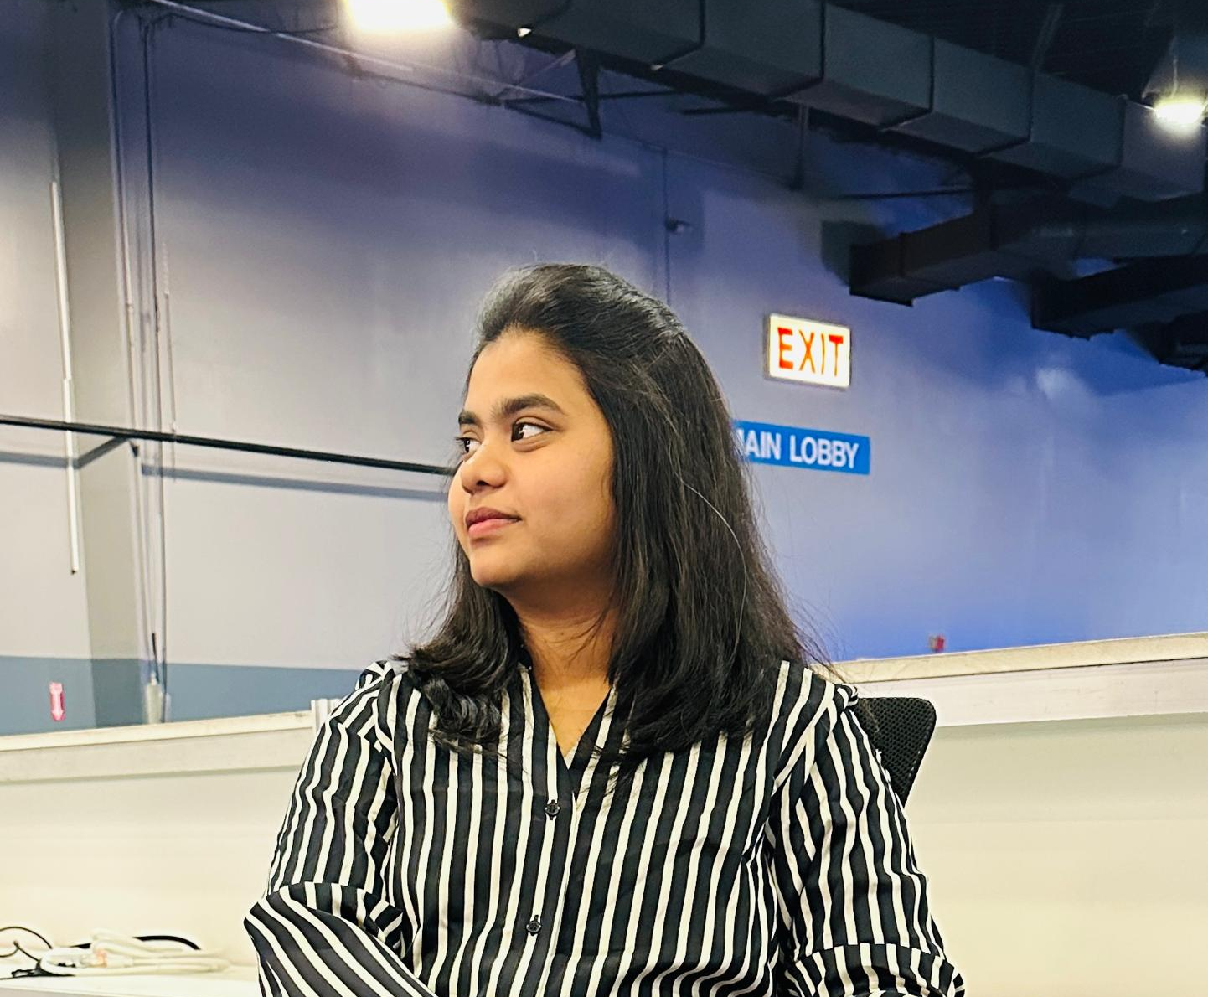


Team Members
Anuhya Marapalli
Rithin Guptha Bajuri
Snehalatha Boothpur
Scrum Master / Developer
Developer
Designer / Developer

Slide 4


Team Members
Harshitha Rangaraju
Srinivas Reddy Bapathu
Team Leader and Developer
Developer and Tester

Slide 5
Improvements
Changing # to sno
Removing sprint word from sprint 3

Slide 6
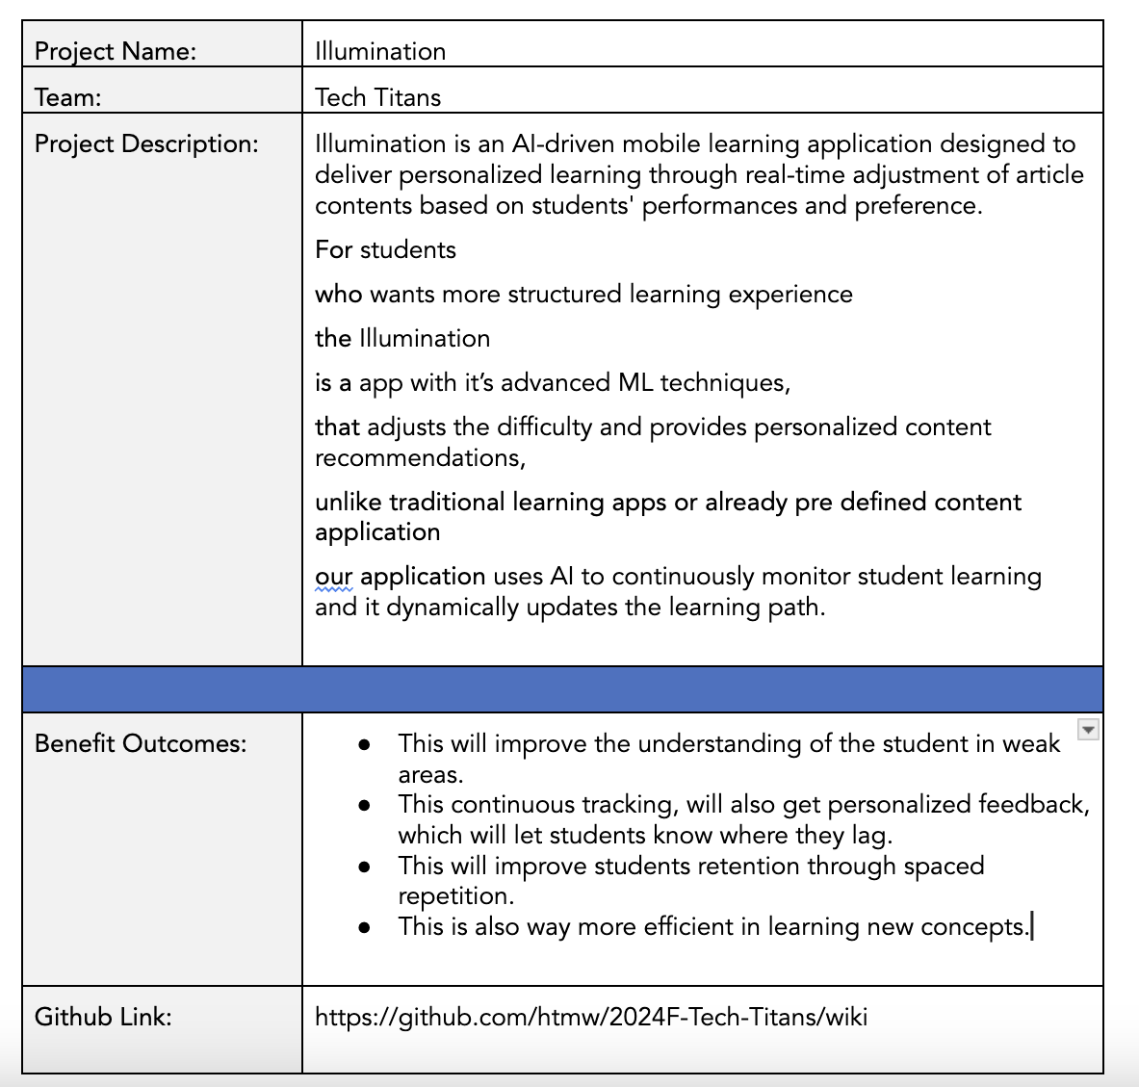
Project Description
BRAND NAME

Slide 7
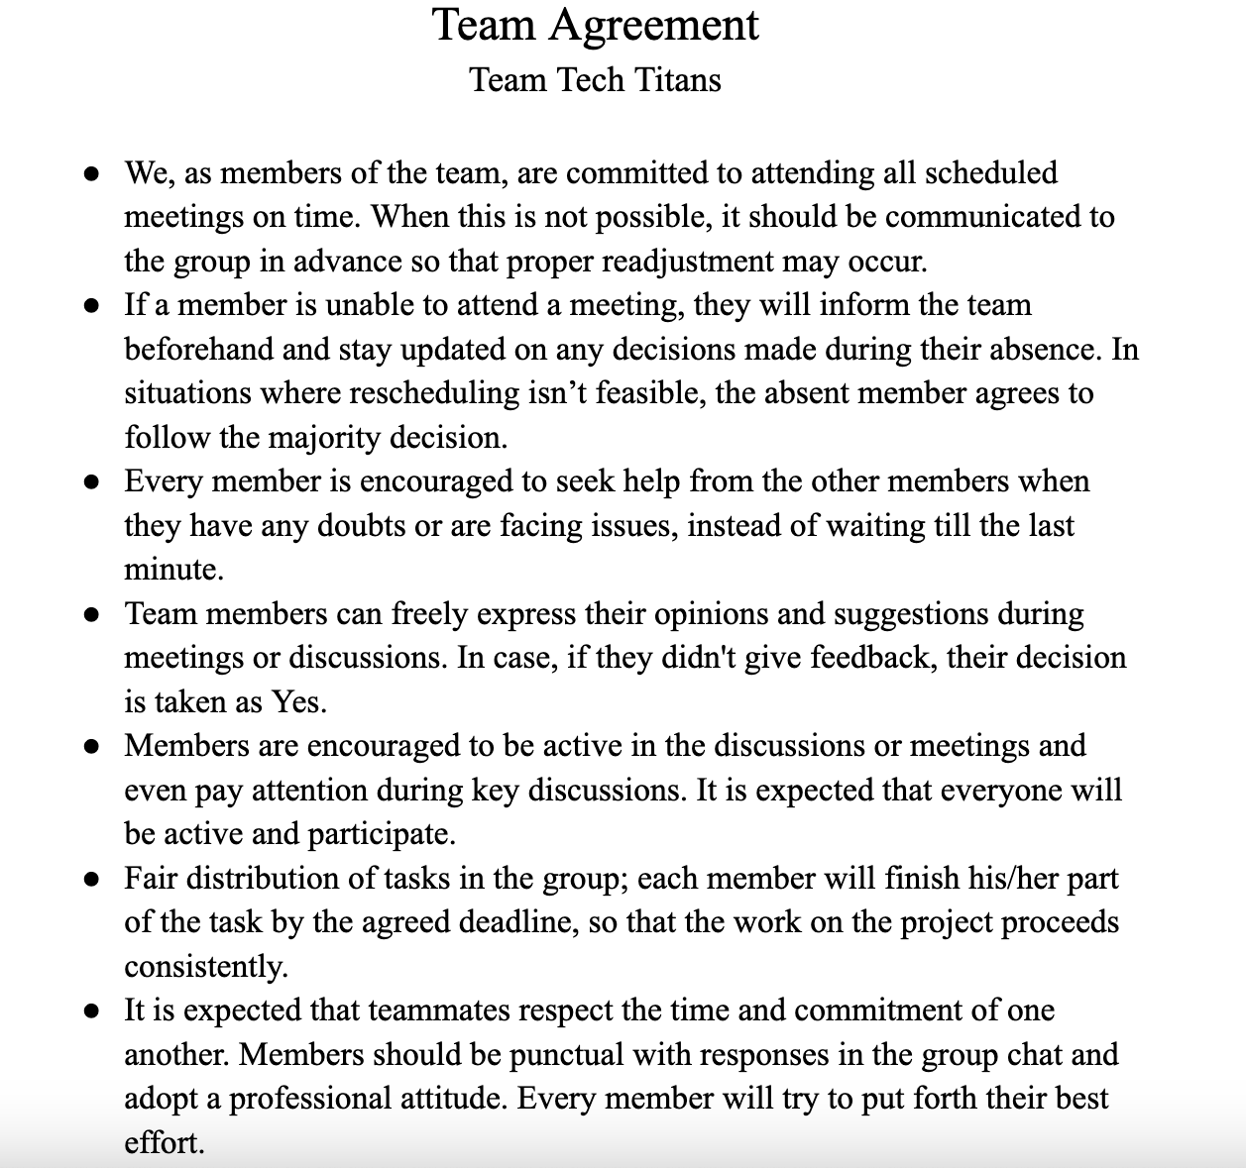
Team Agreement

Slide 8

Ankit, 17 year old
Ankit is a high schooler who is preparing for IIT JEE exams where is he good at Mathematics and Chemistry but he struggles in Physics, even though he attends extra classes, but he never excels it. So, he feels like he personalized study material to improve his weak areas.
Goals:
Have good grasp on difficult physics topics.
Have access to personalized materials on complex topics or topics where he is weak at.
Able to balance school, extra classes and self study.
Challenges
There is a lot of content in online or in books but unable to find proper content for his weakness topics.
Searching for proper material is time taking.
Unable to identify the weak topics.

Slide 9

Rajat, 28 year old
Rajat is CA (Chartered Accountant) aspirant from Mumbai, but he is also working full time in financial firm, which causes him have less time to study. He finds financial reporting and taxation difficult and even struggling to focus because of tight schedule.
Goals:
Improve the understanding of the complex topics.
Able to access the targetted material on the topics which he finds difficult.
Able to balance both work and preparation.
Challenges:
Its difficult to manage both work life and student life which leading him not to study well.
Time consuming on finding the concepts he is weak at.
Struggling to study all because of broad topics in CA.

Slide 10

Kavya, 21 year old
Kavya is engineering student, as she is near her job trails and she is interested in Machine Learning and GenAI, she want to study them and learn them, but she have no idea on machine learning. When she searching of google for roadmap, all those roadmap doesn't suit her well which causes her to distract.
Goals
Master all Machine learning and deep learning concepts.
Able to read fine quality materials which simplify the complex concepts into simple once.
Challenges
There are alot of materials on it which causes to read alot of materials of same topics to understand them.
Facing difficulties in retaining the concepts.
Unable to keep up with the latest trends on ML.

Slide 11
MVP
Subject Selection: Choose subjects to access articles.
Article Reading: Browse and read subject-specific articles.
Mark Articles for Later: Save articles for future review.
Search Functionality: Search articles within a subject.
Personalized Recommendations: Get suggestions based on performance.

Slide 12
Technologies
01.
02.
03.
Backend
Frontend
Tools
fastAPI
Node JS
Mongodb
AWS
Pytorch
React Native
Github
Postman
Google Colab
VSCode

Slide 13





Backend
Here FastAPI is primarily used for machine learning backend tasks where as Node JS is primarily deals with Client Side code. MongoDB for Storing the data. AWS for hosting and even for storing the objective Data. Pytorch for Machine learning

Slide 14

2. Frontend
React Native is used for building cross platform mobile application.

Slide 15




3. Tools
Github is where code and even the documents are shared. Postman is for API Testing. Google Colab for training the Machine Learning Model. VSCode is used for writing the code

Slide 16
Algorithms
Reinforcement Learning
Reinforcement Learning (RL) is a machine learning paradigm where an agent learns by interacting with an environment and receiving rewards for actions. In adaptive learning, RL is used to dynamically adjust content difficulty based on student responses, maximizing engagement and learning efficiency over time.
Word2Vec
Word2Vec is a deep learning-based model that transforms words into continuous vector representations, capturing semantic relationships between words. In content-based filtering, it is used to convert textual content (article text) into vectors, allowing us to measure similarity between content items. Similar vectors imply similar content, enabling personalized recommendations.

Slide 17
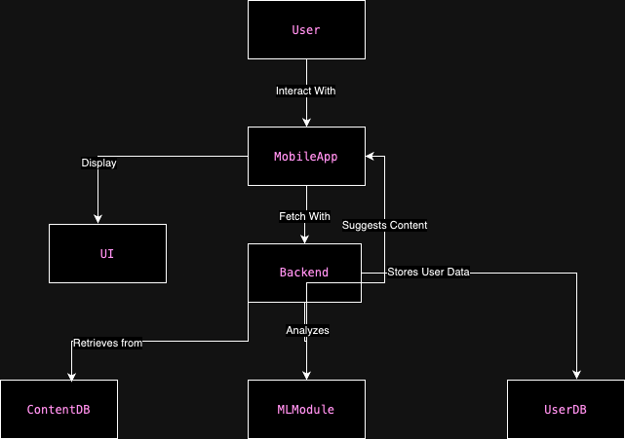
Architecture Diagram

Slide 18
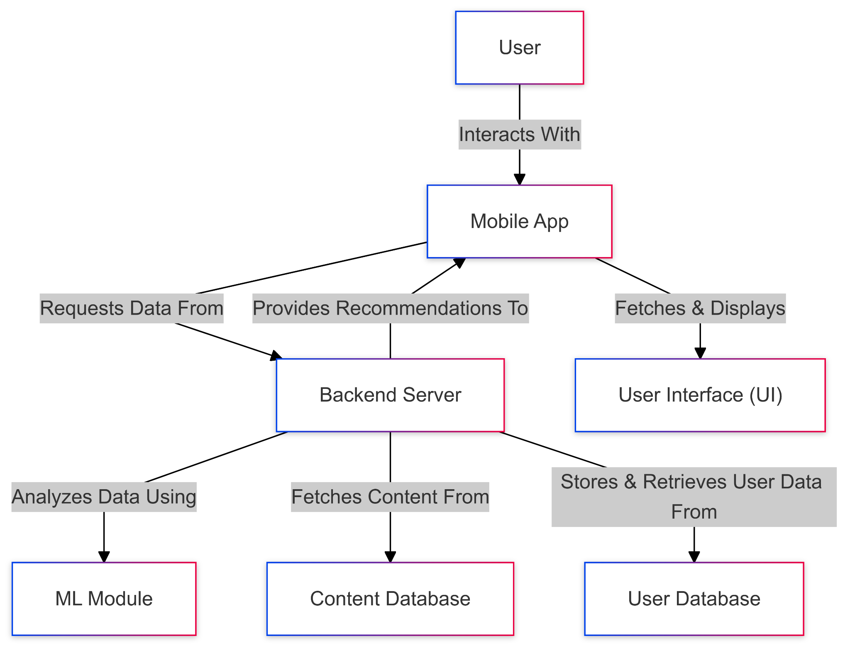
Context Diagram

Slide 19
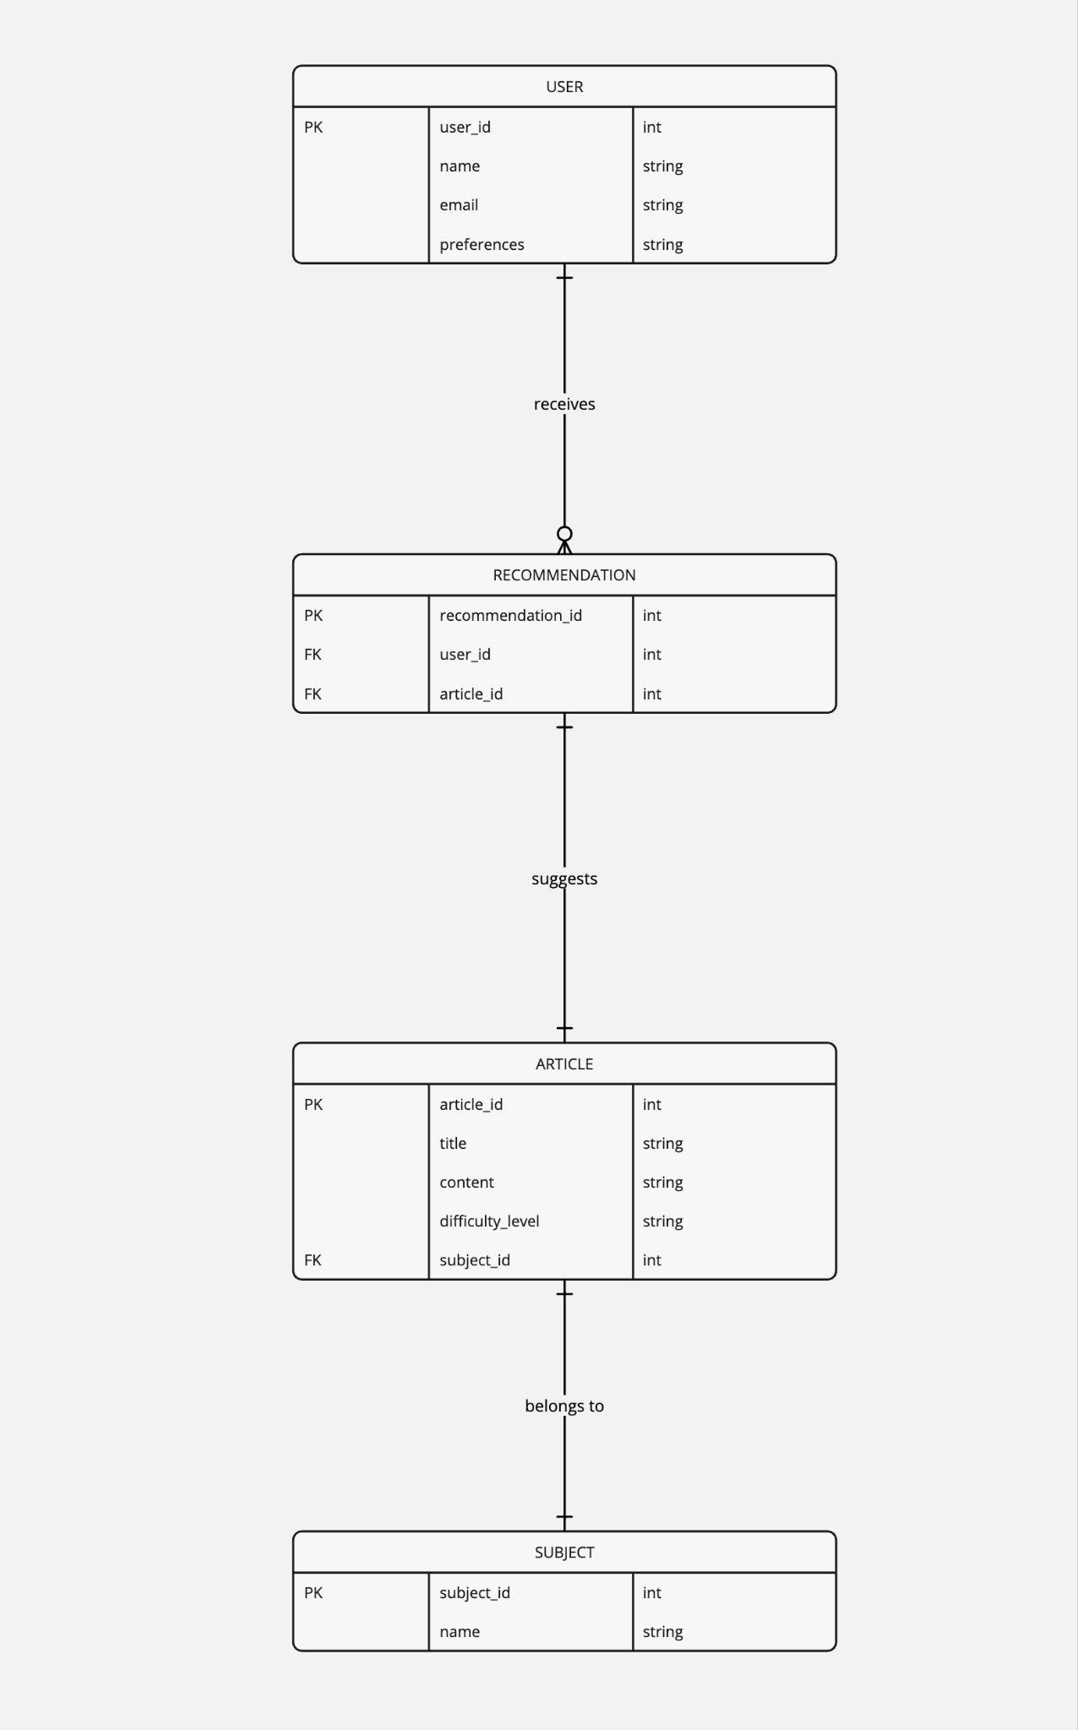
ER Diagram

Slide 20
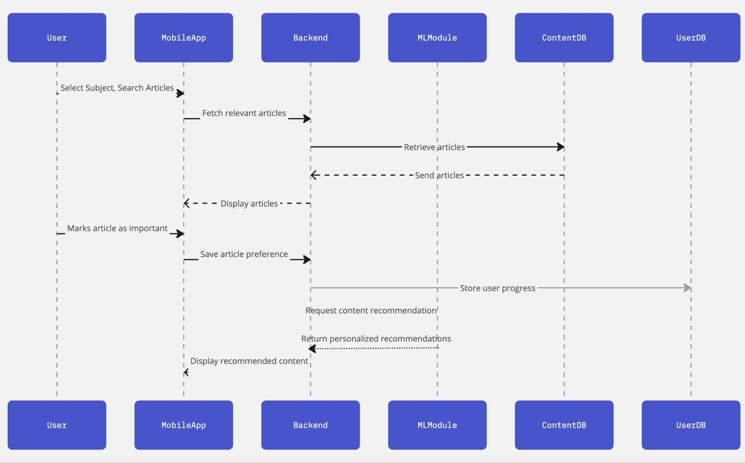
Sequence Diagram

Slide 21
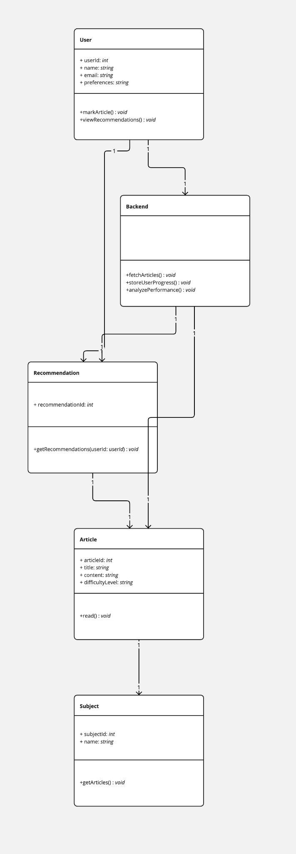
Class Diagram

Slide 22
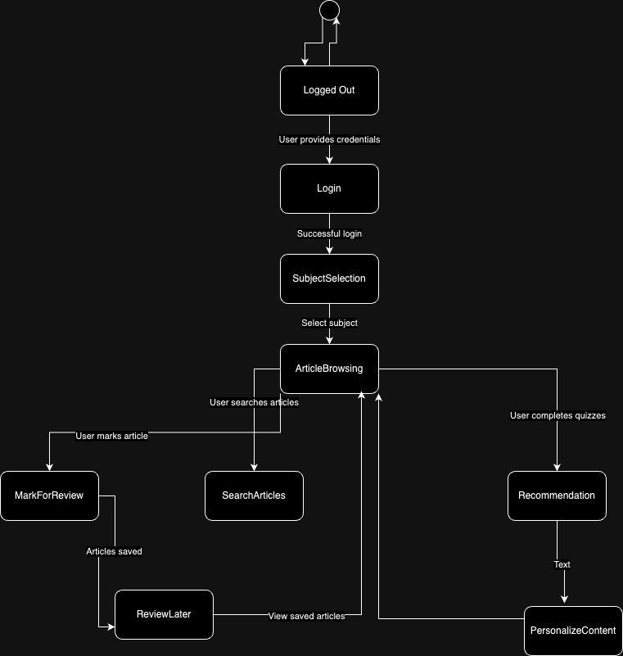
State Diagram

Slide 23
Sprint 2 Recap
Personalized Recommendations: Recommended articles based on quiz performance to address weak areas.
Spaced Repetition: Scheduled prompts for revisiting challenging topics to improve retention.
Performance Dashboard: Visualized progress with quiz scores, time spent, and subject performance.

Slide 24
Product Backlog
SNo | Sprint | Feature | User Story/Technical Story | Acceptance Criteria
1 | Sprint 1 | Subject Selection | User Story 1: As a student, I want to select a subject so I can access relevant learning content. | Users can select from multiple subjects (e.g., Math, Science, History). Selected subjects load relevant articles.
2 | Sprint 1 | Article Reading | User Story 2: As a student, I want to browse and read articles related to the subject I selected. | Articles display in a clean, mobile-friendly interface. Users can scroll and navigate within articles seamlessly.
3 | Sprint 1 | Mark Articles for Later | User Story 3: As a student, I want to mark articles as "difficult" or "important" for later review. | Users can mark articles as "difficult" or "important". Marked articles appear in a "Review Later" section.
4 | Sprint 1 | Article Search | User Story 4: As a student, I want to search for specific articles within a subject. | Users can search for articles by keywords within a subject. Search results are displayed based on relevance.
5 | Sprint 1 | Article Navigation | User Story 5: As a student, I want to navigate between articles within the same subject. | Users can use "next" and "previous" buttons or a navigation bar to move between articles. Ensure smooth transitions.

Slide 25
Product Backlog
SNo | Sprint | Feature | User Story/Technical Story | Acceptance Criteria
6 | Sprint 1 | Basic UI for Articles | Technical Story 1: Set up basic UI/UX for browsing and reading articles. | Clean, intuitive design for subject selection and article reading. Ensure mobile responsiveness.
7 | Sprint 1 | Content Management System | Technical Story 2: Implement content management system for loading articles by subject. | Articles are stored and categorized by subject. Efficient retrieval of content from a backend system.
8 | Sprint 1 | Mark and Save Articles | Technical Story 3: Add functionality for marking and saving articles for later review. | Users can save marked articles to a "Review Later" list. Data is persisted across sessions.
9 | Sprint 1 | Search Functionality | Technical Story 4: Implement article search functionality. | Enable a search feature within each subject. Search results are displayed quickly and accurately.
10 | Sprint 2 | Personalized Recommendations | User Story 6: As a student, I want personalized content recommendations based on my performance so I can improve weak areas. | The system provides content recommendations based on quiz performance and article difficulty. Users are directed to articles covering weak areas.

Slide 26
Product Backlog
SNo | Sprint | Feature | User Story/Technical Story | Acceptance Criteria
11 | Sprint 2 | Spaced Repetition | User Story 7: As a student, I want the app to implement spaced repetition to reinforce key concepts over time. | The app identifies and schedules spaced repetition for topics users struggle with. Users are prompted to revisit articles or take quizzes at optimal intervals.
12 | Sprint 2 | Performance Dashboard | User Story 8: As a student, I want to track my progress in a performance dashboard. | The dashboard shows quiz scores, articles read, and time spent on each subject. Users can see areas of strength and weakness visually.
13 | Sprint 2 | Targeted Feedback on Quizzes | User Story 9: As a student, I want to receive targeted feedback after quizzes so I can understand my mistakes. | Detailed feedback is provided for each quiz question. Feedback explains why certain answers are correct/incorrect.
14 | Sprint 2 | Dynamic Content Adjustment | User Story 10: As a student, I want the app to dynamically adjust content difficulty based on my performance. | The difficulty of content increases if the user performs well. If a student struggles, simpler articles or review content is recommended.
15 | Sprint 2 | Basic Machine Learning for Recommendations | Technical Story 5: Implement a basic machine learning model for personalized content recommendations. | The model analyzes quiz performance and article difficulty to recommend personalized learning paths. Adjustments are made based on user progress.

Slide 27
Product Backlog
SNo | Sprint | Feature | User Story/Technical Story | Acceptance Criteria
16 | Sprint 2 | Spaced Repetition Algorithm | Technical Story 6: Integrate spaced repetition algorithm to reinforce key concepts. | Use spaced repetition techniques to schedule when users should revisit difficult topics. Ensure the system prompts users at the right time for maximum retention.
17 | Sprint 2 | Performance Dashboard Development | Technical Story 7: Build a performance dashboard to visualize progress. | The dashboard shows quiz results, time spent, and subject mastery. Visual charts display performance trends.
18 | Sprint 2 | Quiz Feedback Mechanism | Technical Story 8: Provide detailed quiz feedback for user learning. | Implement feedback mechanisms to explain quiz results. Feedback is both constructive and designed to reinforce learning.
19 | Sprint 3 | User Accounts & Syncing | User Story 11: As a student, I want to create an account and log in so I can save my progress and preferences across devices. | Users can create accounts with email/password. User progress, preferences, and recommendations are saved and synced across devices.
20 | Sprint 3 | Adaptive Study Paths | User Story 12: As a student, I want my study path to adapt based on my long-term learning trends and preferences. | The app uses ML to analyze long-term trends and dynamically adjust learning paths. Preferences are stored, and content is adapted based on user learning styles.

Slide 28
Product Backlog
SNo | Sprint | Feature | User Story/Technical Story | Acceptance Criteria
21 | Sprint 3 | Reminders for Spaced Repetition & Recommendations | User Story 13: As a student, I want to receive reminders for spaced repetition and personalized study recommendations. | Notifications prompt users for spaced repetition and recommended articles. Reminders are personalized based on past performance and study schedules.
22 | Sprint 3 | Learning History | User Story 14: As a student, I want to view my learning history so I can review previously studied articles and performance. | Users can access their study history, including completed articles and quizzes. History includes quiz scores, article read dates, and time spent.
23 | Sprint 3 | Adaptive Feedback Based on Trends | User Story 15: As a student, I want to receive adaptive feedback based on my performance trends over time so I can improve continuously. | The app provides adaptive feedback based on overall performance and trends. Feedback is more tailored as the system learns from the user’s progress and actions.
24 | Sprint 3 | User Authentication | Technical Story 9: Implement user authentication and profile management. | Secure user authentication system with account creation, login, and password recovery. Ensure user progress and data are stored across sessions.
25 | Sprint 3 | Refined ML for Long-Term Learning | Technical Story 10: Refine the machine learning model for adaptive feedback based on long-term learning trends. | The ML model adapts based on user learning patterns and feedback. Ensure the model evolves based on long-term trends and personalized learning data.

Slide 29
Product Backlog
S.NO | Sprint | Feature | User Story/Technical Story | Acceptance Criteria
26 | Sprint 3 | Reminders & Notifications | Technical Story 11: Implement reminders and notifications for spaced repetition and content recommendations. | Notifications are sent based on spaced repetition schedules and content recommendations. Ensure reminders are relevant and personalized to user learning paths.
27 | Sprint 3 | Final UI/UX Improvements | Technical Story 12: Finalize UI/UX improvements for a polished, engaging user experience. | Refine the user interface for a smooth, intuitive experience. Ensure the app is fully responsive and accessible on different devices.

Slide 30
Sprint 3
# | Sprint | Story/Task | Story Points | Acceptance Criteria
1 | Sprint 3 | User Story 11: User Accounts & Syncing | 8 Points | Users can create accounts with email/password. User progress, preferences, and recommendations are saved and synced across devices.
2 | Sprint 3 | User Story 12: Adaptive Study Paths | 13 Points | The app uses ML to analyze long-term trends and dynamically adjust learning paths. Preferences are stored, and content is adapted based on user learning styles.
3 | Sprint 3 | User Story 13: Reminders for Spaced Repetition & Recommendations | 5 Points | Notifications prompt users for spaced repetition and recommended articles. Reminders are personalized based on past performance and study schedules.
4 | Sprint 3 | User Story 14: Learning History | 8 Points | Users can access their study history, including completed articles and quizzes. History includes quiz scores, article read dates, and time spent.
5 | Sprint 3 | User Story 15: Adaptive Feedback Based on Trends | 8 Points | The app provides adaptive feedback based on overall performance and trends. Feedback is more tailored as the system learns from the user’s progress and actions.

Slide 31
Sprint 3
# | Sprint | Story/Task | Story Points | Acceptance Criteria
6 | Sprint 3 | Technical Story 9: User Authentication | 3 Points | Secure user authentication system with account creation, login, and password recovery. Ensure user progress and data are stored across sessions.
7 | Sprint 3 | Technical Story 10: Refined ML for Long-Term Learning | 8 Points | The ML model adapts based on user learning patterns and feedback. Ensure the model evolves based on long-term trends and personalized learning data.
8 | Sprint 3 | Technical Story 11: Reminders & Notifications | 5 Points | Notifications are sent based on spaced repetition schedules and content recommendations. Ensure reminders are relevant and personalized to user learning paths.
9 | Sprint 3 | Technical Story 12: Final UI/UX Improvements | 3 Points | Refine the user interface for a smooth, intuitive experience. Ensure the app is fully responsive and accessible on different devices.
10 | Sprint 2 (Carryover) | User Story 9: Targeted Feedback on Quizzes | 5 Points | Detailed feedback is provided for each quiz question. Feedback explains why certain answers are correct/incorrect.

Slide 32
Sprint 3
# | Sprint | Story/Task | Story Points | Acceptance Criteria
11 | Sprint 2 (Carryover) | User Story 10: Dynamic Content Adjustment | 8 Points | The difficulty of content increases if the user performs well. If a student struggles, simpler articles or review content is recommended.
12 | Sprint 2 (Carryover) | Technical Story 8: Quiz Feedback Mechanism | 5 Points | Implement feedback mechanisms to explain quiz results. Feedback is both constructive and designed to reinforce learning.

Slide 33
Test Cases
Story/Task | Test Case ID | Test Case Description | Preconditions | Steps | Expected Result | Status
User Story 11: User Accounts & Syncing | TC-11-01 | Test account creation with valid email and password | None | 1. Navigate to the signup page. 2. Enter a valid email and password. 3. Click "Sign Up". | Account is successfully created, and the user is redirected to the dashboard. | Pass
User Story 11: User Accounts & Syncing | TC-11-02 | Test account syncing across devices | Account already created | 1. Log in to the account on Device A. 2. Perform some actions (e.g., complete a quiz). 3. Log in on Device B. | Progress and preferences are consistent across devices. | Fail
User Story 12: Adaptive Study Paths | TC-12-01 | Test ML-based study path adjustment | User has completed a sufficient number of quizzes | 1. Complete quizzes with varying results. 2. Observe the recommended study path. | The study path dynamically adjusts based on long-term trends and preferences. | Pass
User Story 12: Adaptive Study Paths | TC-12-02 | Test preference-based content adaptation | User has updated preferences | 1. Update preferences in the settings. 2. Observe the changes in recommended content. | Recommendations align with updated preferences. | Pass

Slide 34
Test Cases
Story/Task | Test Case ID | Test Case Description | Preconditions | Steps | Expected Result | Status
User Story 13: Reminders for Spaced Repetition & Recommendations | TC-13-01 | Test spaced repetition notification | Spaced repetition content exists for the user | 1. Enable notifications in the app. 2. Wait for the scheduled reminder. 3. Observe the notification. | User receives a notification for spaced repetition. | Fail
User Story 13: Reminders for Spaced Repetition & Recommendations | TC-13-02 | Test recommendation notification | Recommendations available | 1. Enable notifications in the app. 2. Wait for the scheduled reminder. 3. Observe the notification. | User receives a personalized recommendation notification. | Pass
User Story 14: Learning History | TC-14-01 | Test access to learning history | User has completed quizzes or read articles | 1. Navigate to the learning history page. 2. Observe displayed data. | History includes completed articles, quizzes, scores, and time spent. | Pass
User Story 14: Learning History | TC-14-02 | Test accurate history display | Multiple articles/quizzes completed | 1. Complete multiple articles and quizzes. 2. Verify the accuracy of history data. | All activities are accurately displayed in the history. | Pass

Slide 35
Test Cases
Story/Task | Test Case ID | Test Case Description | Preconditions | Steps | Expected Result | Status
User Story 15: Adaptive Feedback Based on Trends | TC-15-01 | Test feedback based on performance trends | Sufficient data exists for trend analysis | 1. Complete multiple quizzes. 2. Observe the feedback provided in the dashboard or after quizzes. | Feedback reflects long-term trends and offers actionable insights. | Fail
Technical Story 9: User Authentication | TC-09-01 | Test login functionality | Account exists | 1. Navigate to the login page. 2. Enter valid credentials. 3. Click "Log In". | User successfully logs in and is redirected to the dashboard. | Pass
Technical Story 9: User Authentication | TC-09-02 | Test password recovery | Account exists | 1. Navigate to the "Forgot Password" page. 2. Enter registered email. 3. Submit the form. | Password recovery email is sent to the user. | Pass
User Story 9: Targeted Feedback on Quizzes | TC-09-01 | Test detailed feedback for correct answers | Quiz completed | 1. Answer questions in a quiz. 2. Observe feedback for correct answers. | Feedback explains why the answer is correct. | Pass

Slide 36
Test Cases
Story/Task | Test Case ID | Test Case Description | Preconditions | Steps | Expected Result | Status
User Story 9: Targeted Feedback on Quizzes | TC-09-02 | Test detailed feedback for incorrect answers | Quiz completed | 1. Answer questions in a quiz. 2. Observe feedback for incorrect answers. | Feedback explains why the answer is incorrect and provides resources. | Pass
User Story 10: Dynamic Content Adjustment | TC-10-01 | Test difficulty adjustment based on user performance | User has completed quizzes | 1. Complete quizzes with good scores. 2. Observe the next recommended content. | Recommended content increases in difficulty for high scores. | Pass
User Story 10: Dynamic Content Adjustment | TC-10-02 | Test content simplification for struggling users | User has performed poorly in quizzes | 1. Complete quizzes with low scores. 2. Observe the next recommended content. | Simplified or review content is recommended. | Pass

Slide 37
Sprint 3 Completed Stories
Story/Task | Story Points
User Story 11: User Accounts & Syncing | 8 Points
User Story 12: Adaptive Study Paths | 13 Points
User Story 13: Reminders for Spaced Repetition & Recommendations | 5 Points
User Story 14: Learning History | 8 Points
User Story 15: Adaptive Feedback Based on Trends | 8 Points
Technical Story 9: User Authentication | 3 Points
Technical Story 10: Refined ML for Long-Term Learning | 8 Points
Technical Story 11: Reminders & Notifications | 5 Points
Technical Story 12: Final UI/UX Improvements | 3 Points

Slide 38
Sprint 3 Not Completed Stories
Story/Task | Story Points
User Story 13: Reminders for Spaced Repetition & Recommendations | 5 Points
User Story 15: Adaptive Feedback Based on Trends | 8 Points
Technical Story 11: Reminders & Notifications | 5 Points

Slide 39
Team Velocity - This Sprint
Total Story Points Completed: 66 Points

Slide 40
Team's Historical Velocity (Average)
Historical Velocity (Average): Calculated by averaging the total points completed across previous sprints (excluding Sprint 0).
Sprint 1: 42 points
Sprint 2: 42 points
Sprint 3: 66 points
Average Velocity: 50 story points

Slide 41
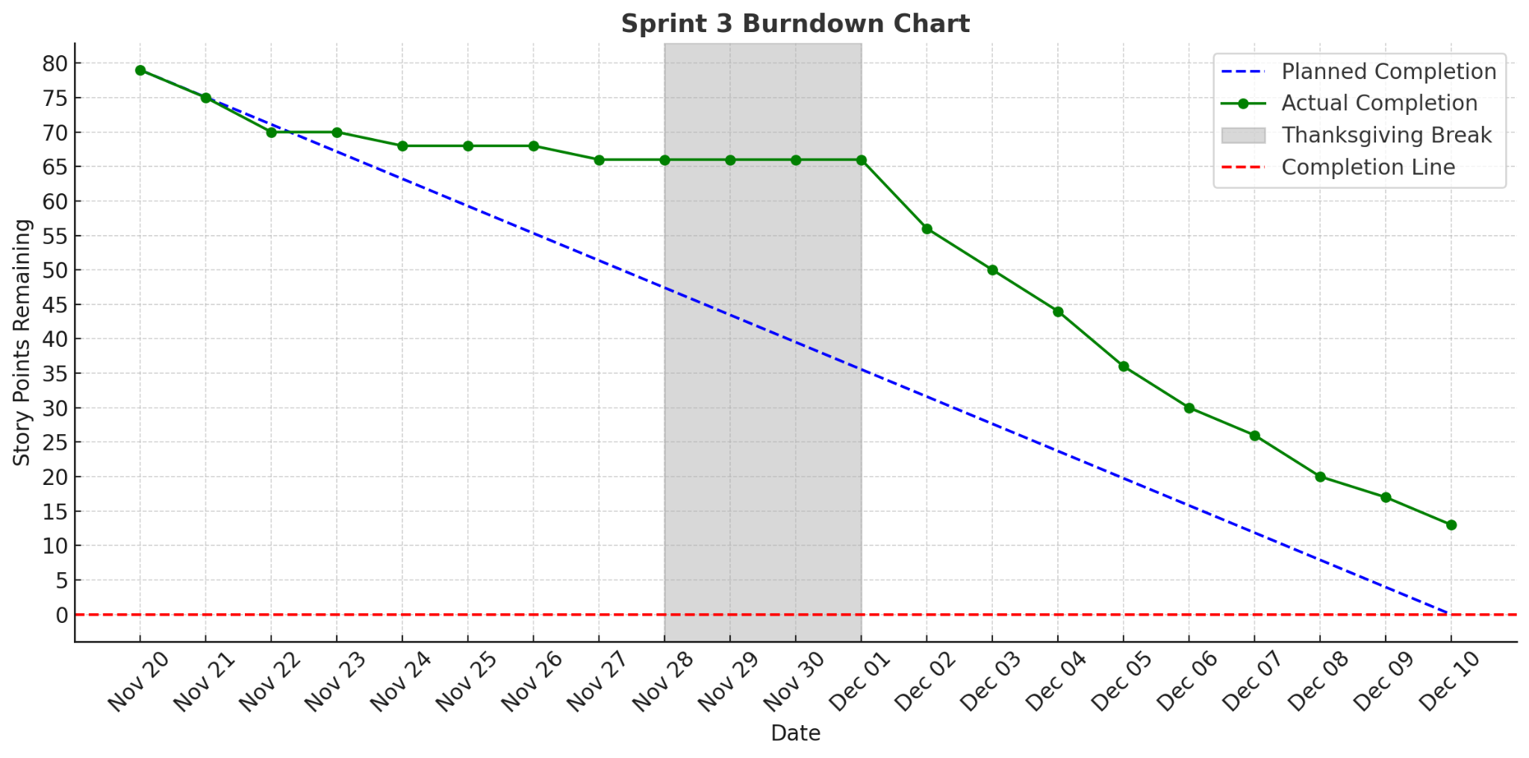
Burndown Chart - Sprint 3

Slide 42
Completed/Committed Ratio
Committed: 79 story points
Completed: 66 story points
Ratio: (66 / 79) * 100 = 83.54%

Slide 43
Completed/Committed Ratio - Average and Historical
Sprint 1: 100% completion (42 out of 42 points)
Sprint 2: 70% completion (42 out of 60 points)
Sprint 3: 83.54% completion (66 out of 79 points)
Average Completed/Committed Ratio: (100 + 70 + 83.54 ) / 3 = 84.51%

Slide 44
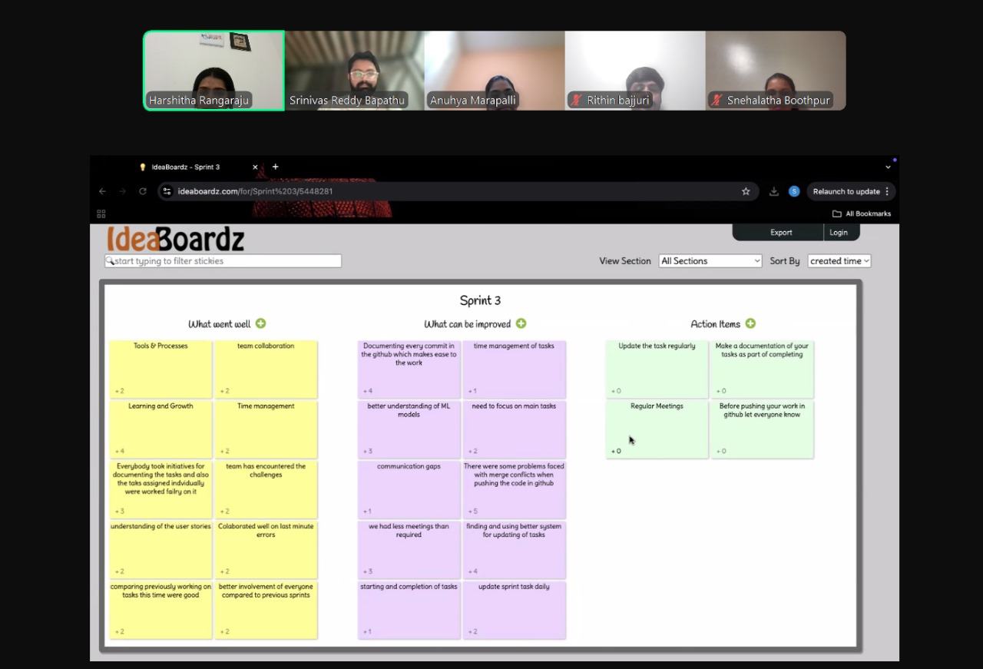
Retrospective

Slide 45
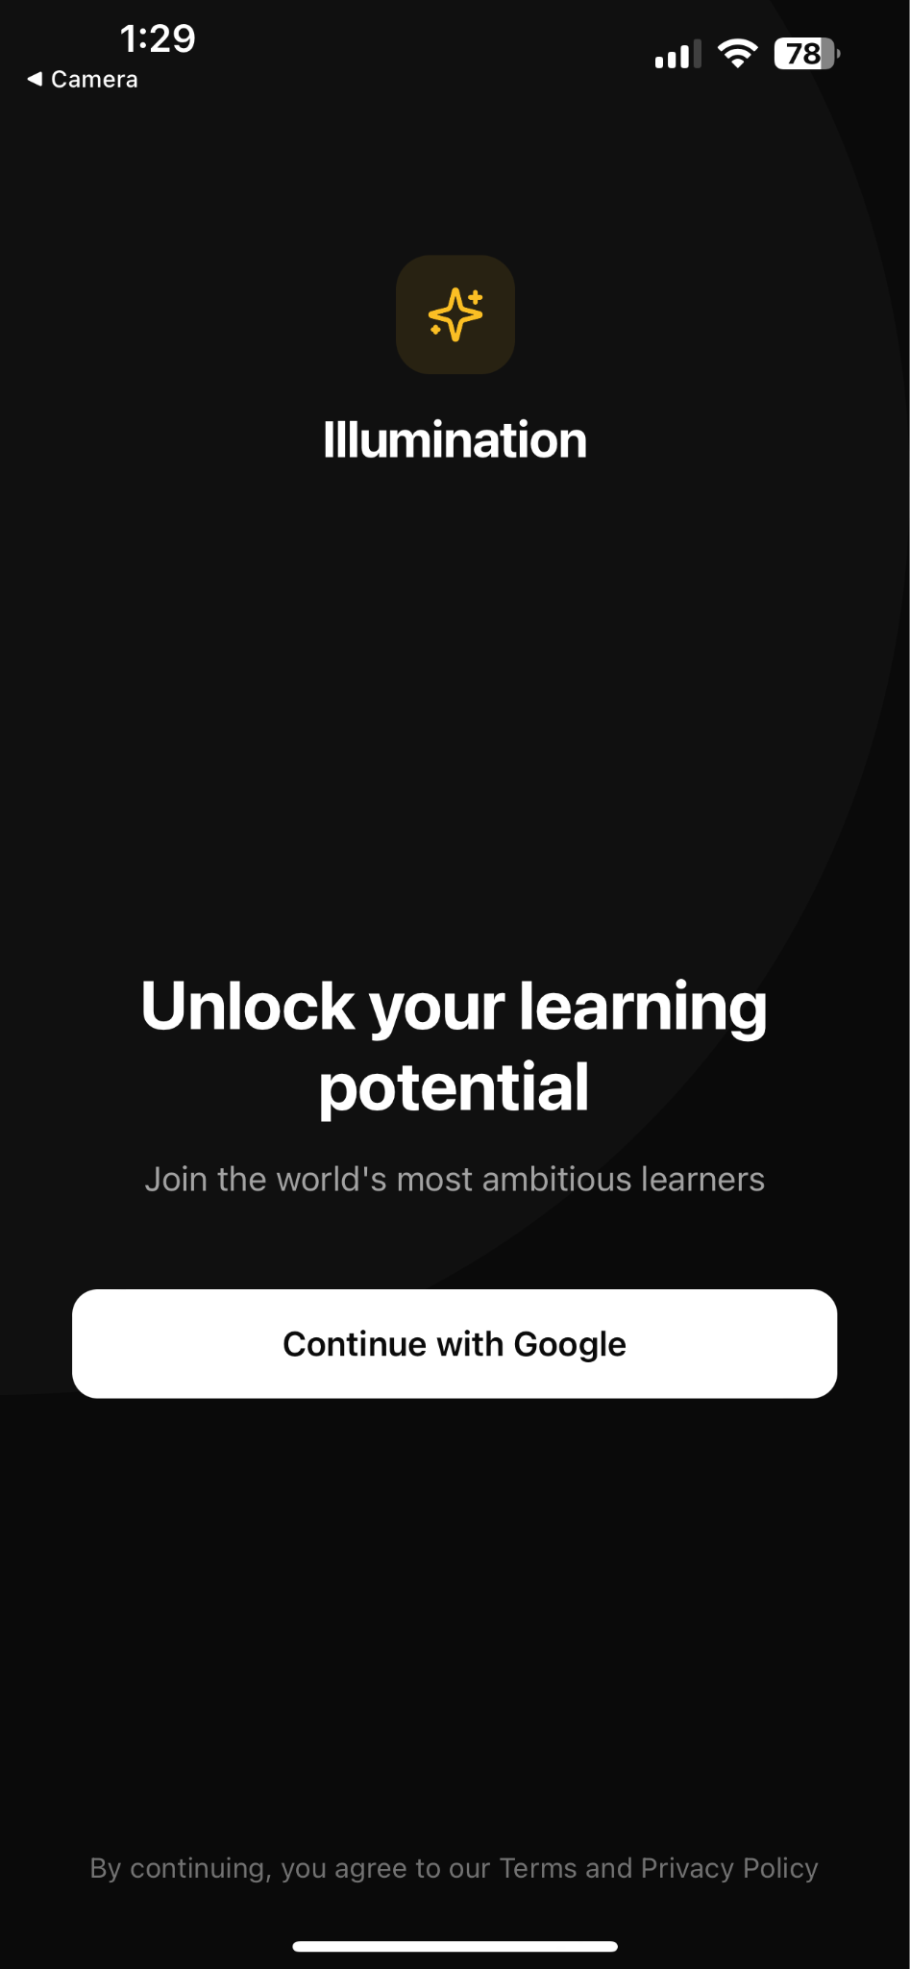
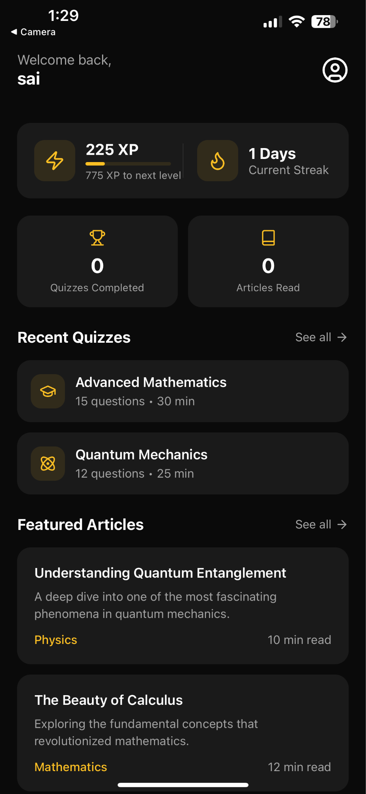
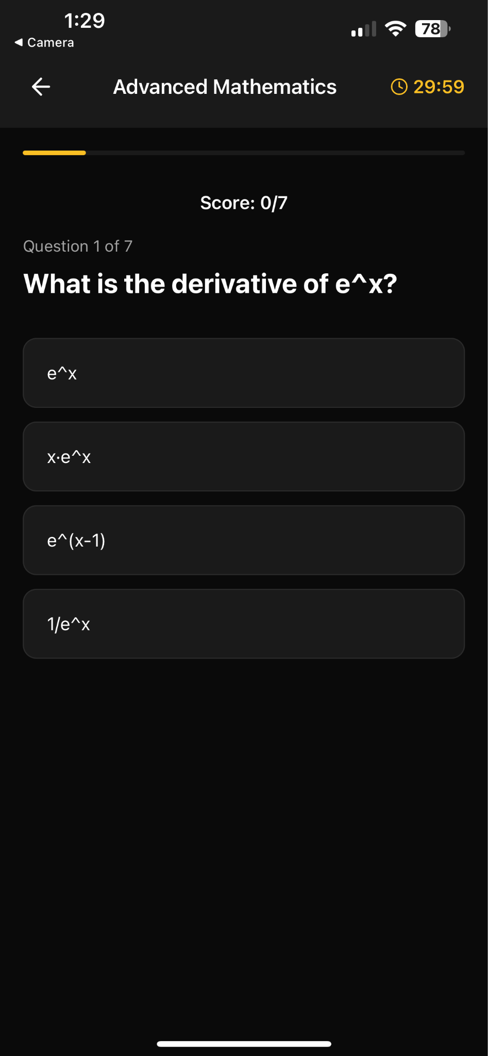
App Screenshots

Slide 46
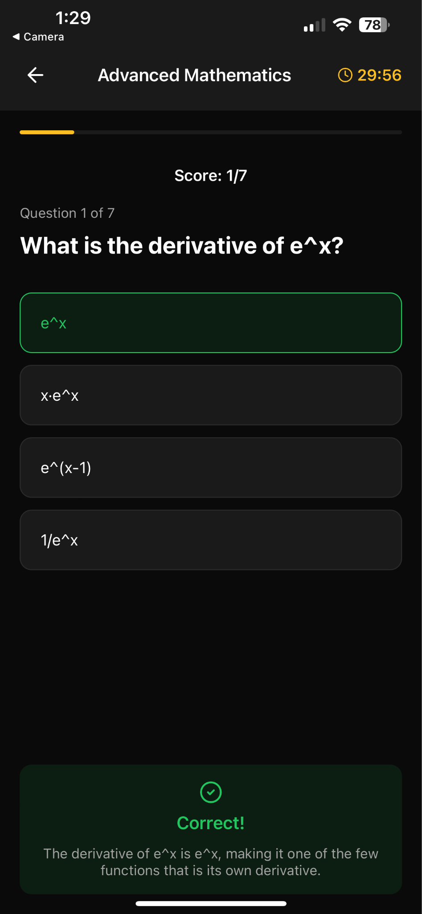
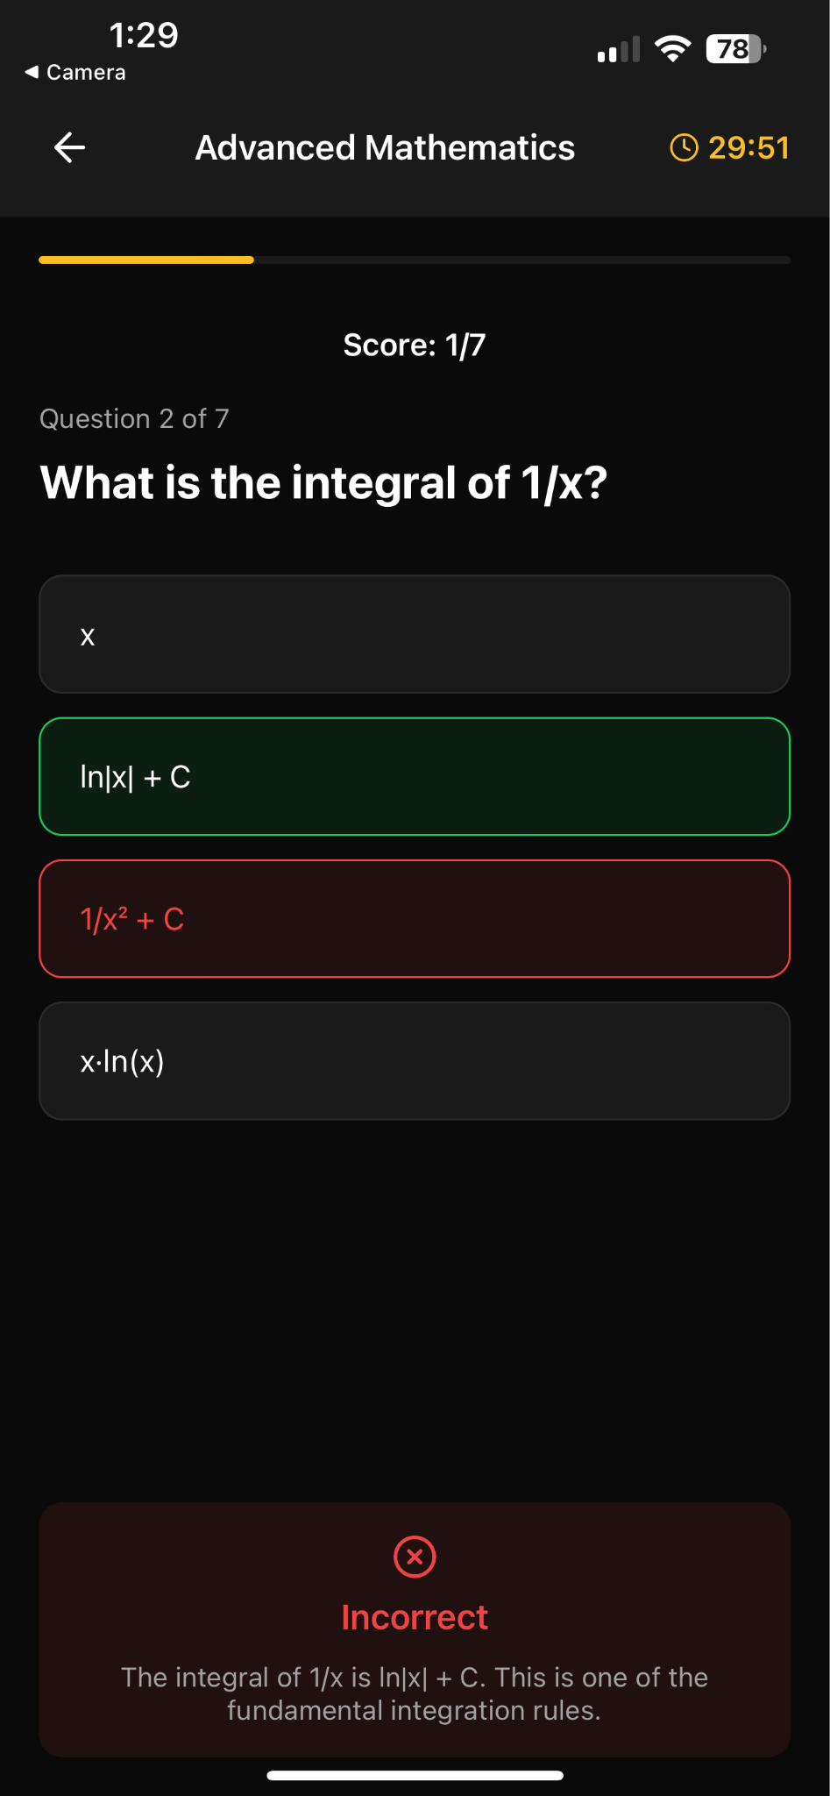
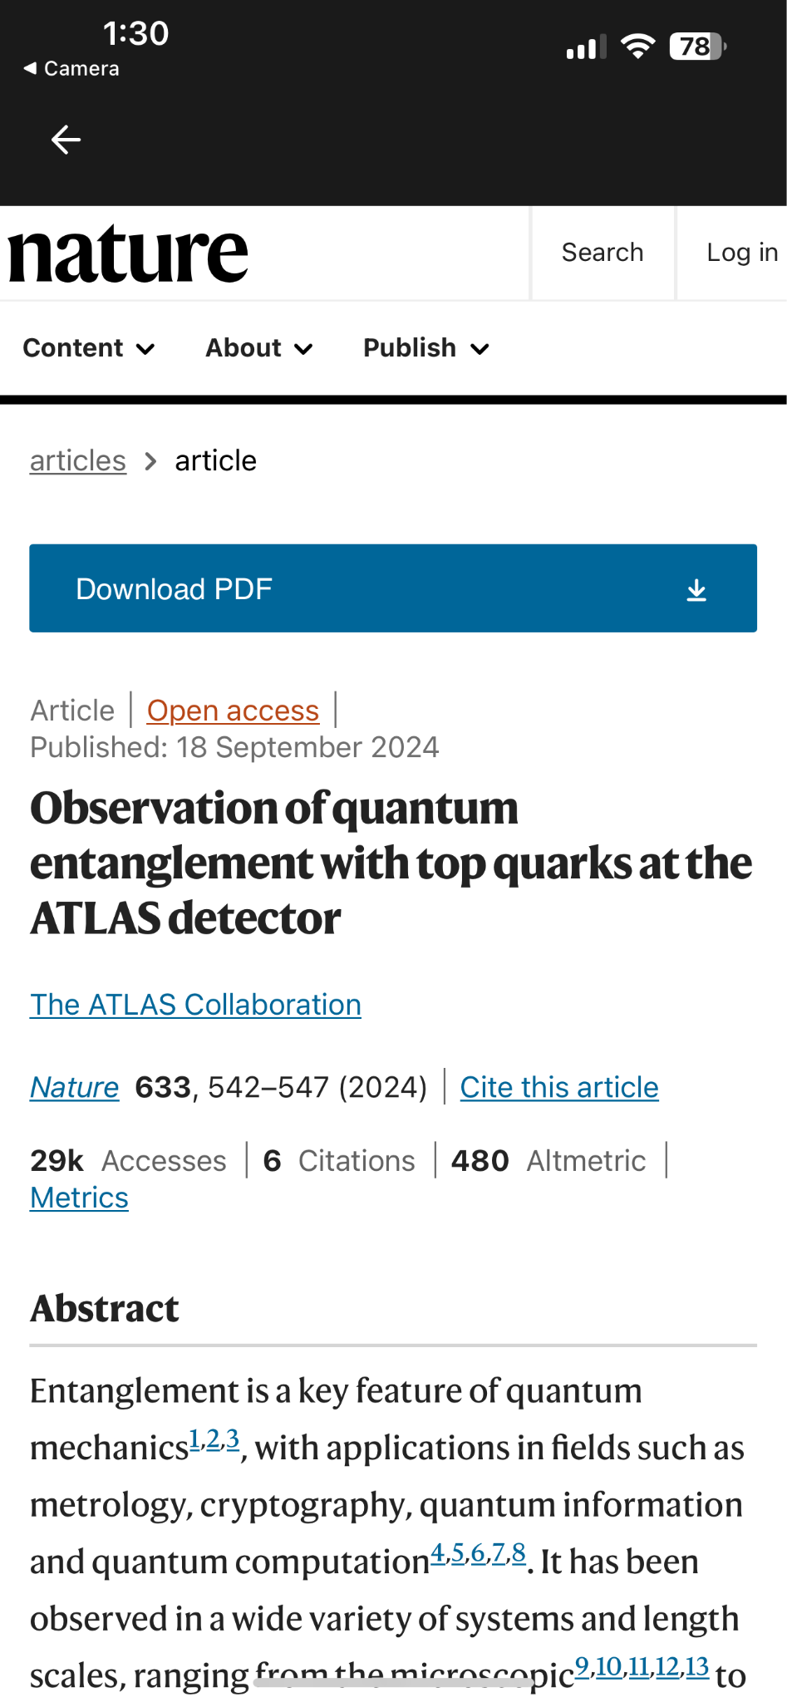
App Screenshots

Slide 47
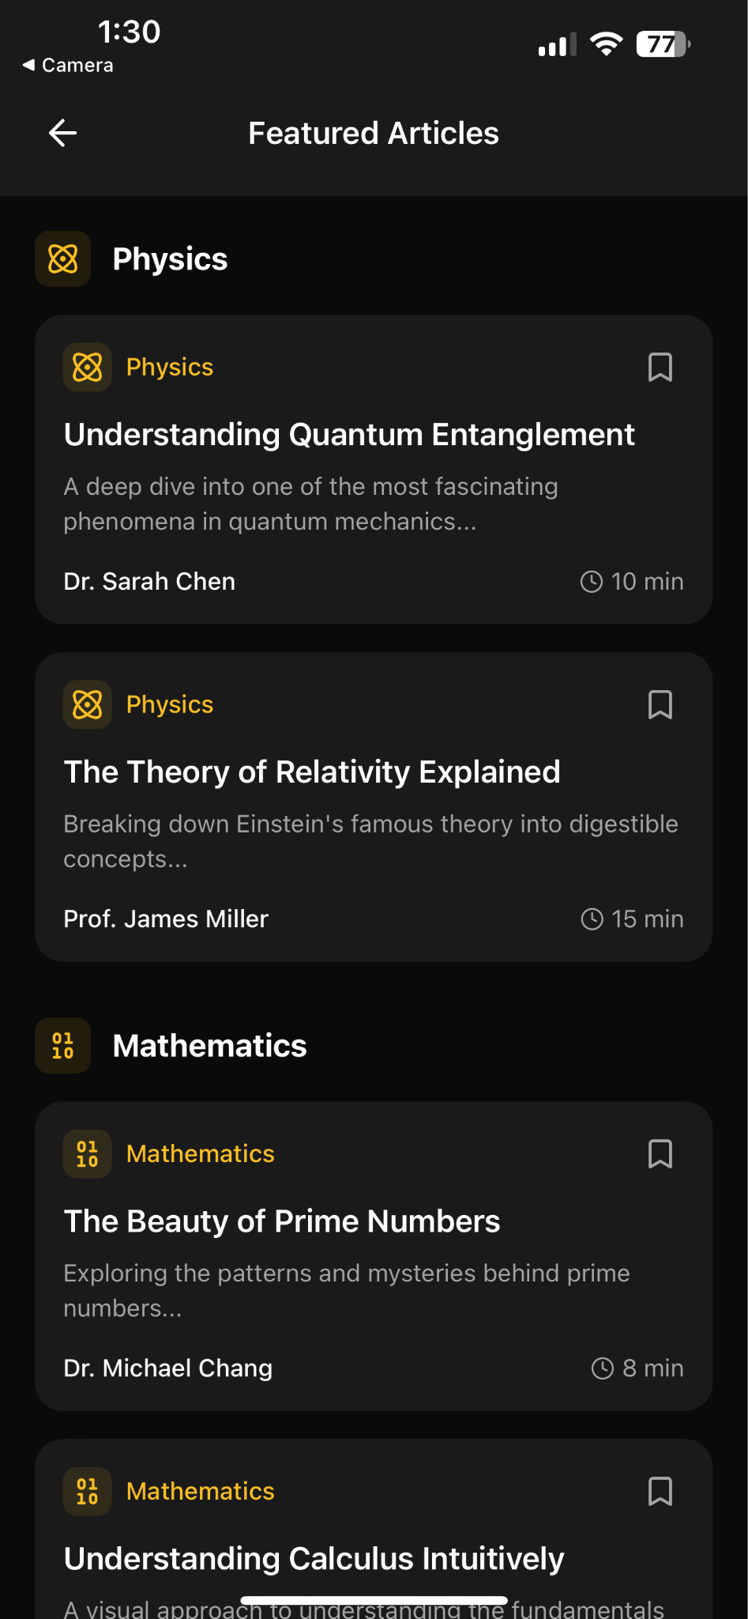
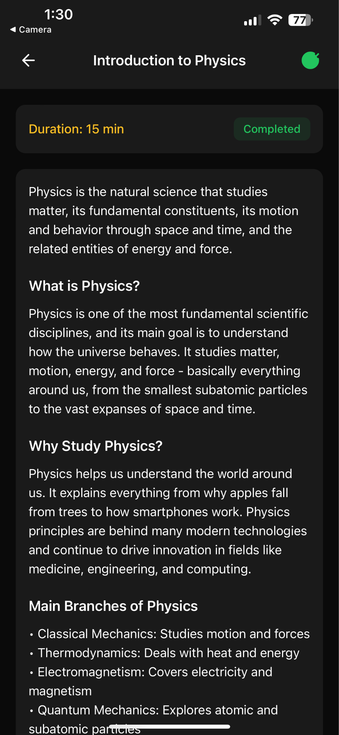
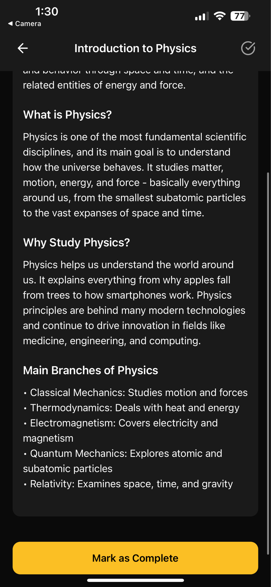
App Screenshots

Slide 48
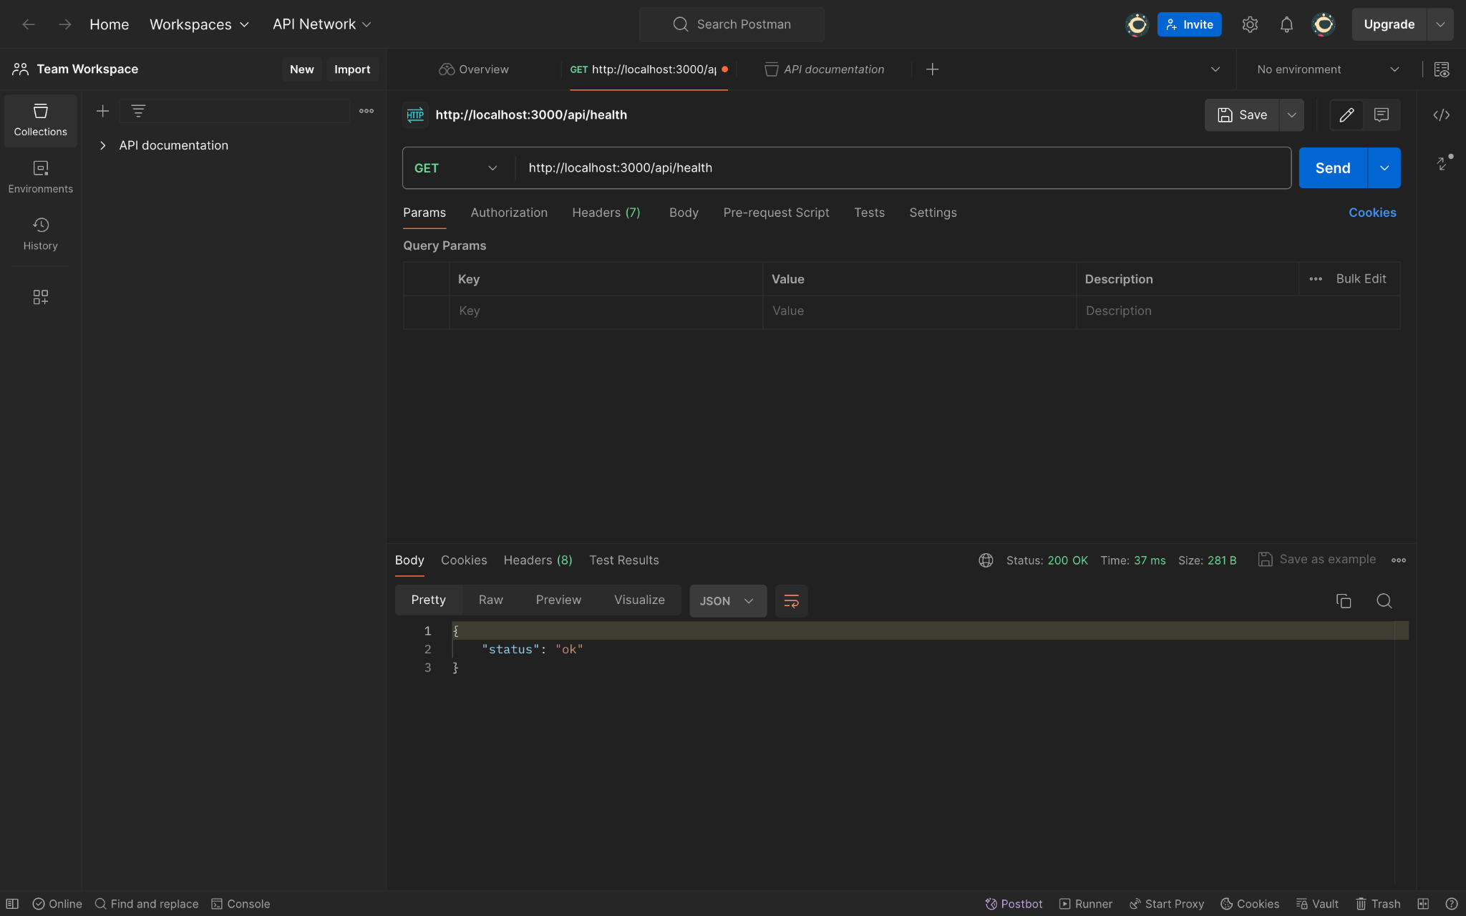
API

Slide 49
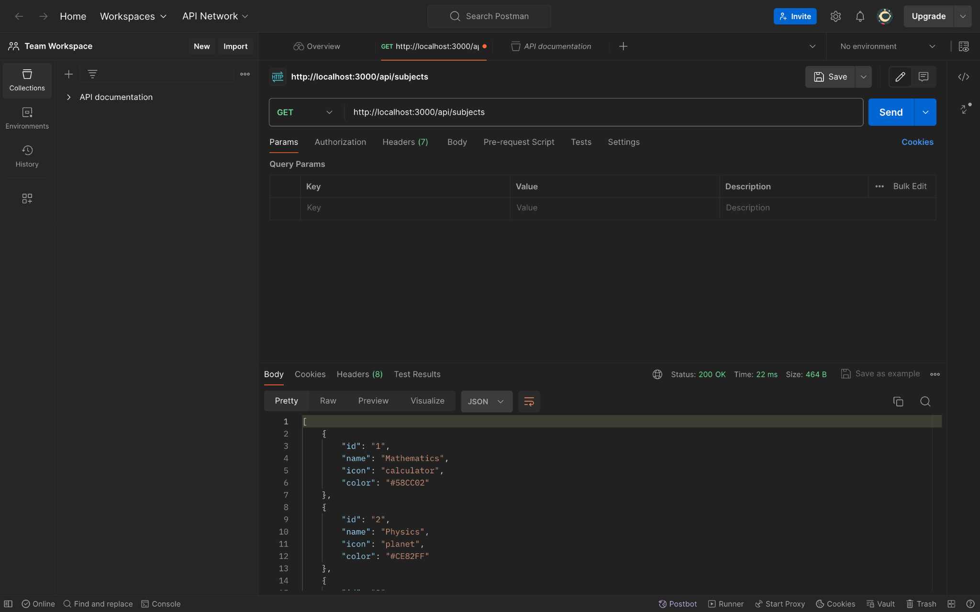
API

Slide 50
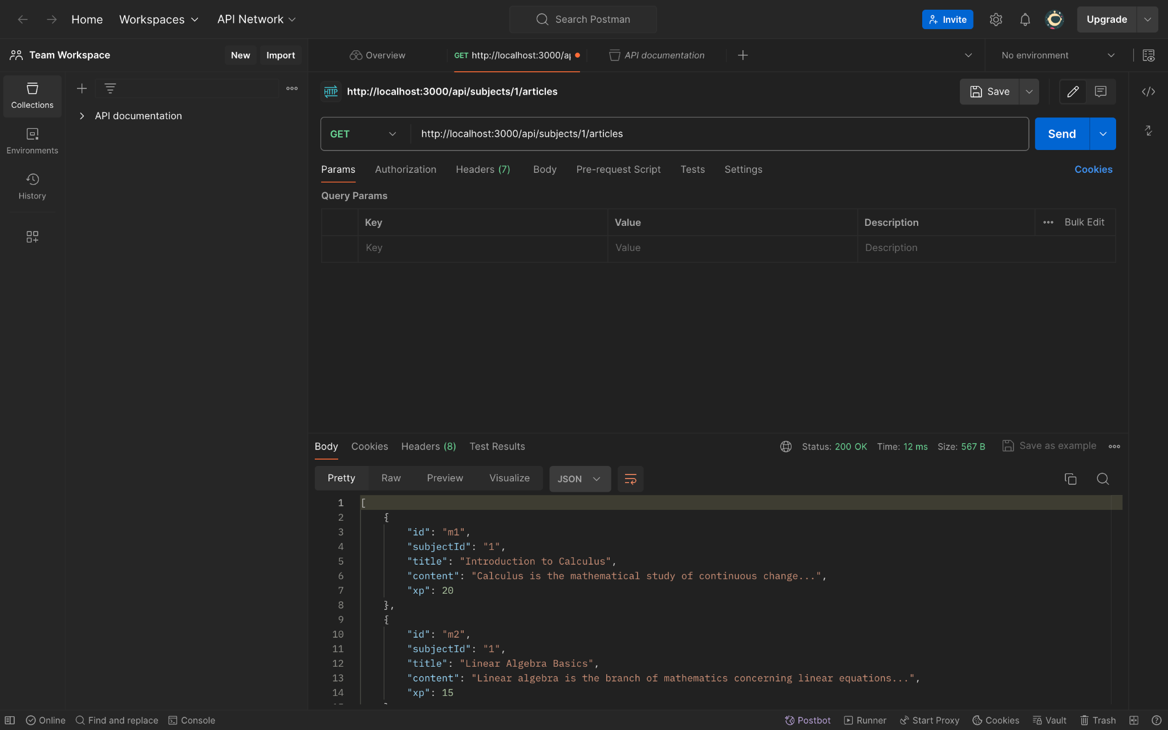
API

Slide 51

API

Slide 52
Wiki Link
https://github.com/htmw/2024F-Tech-Titans/wiki

Slide 53
Live Demo

